Slide 1
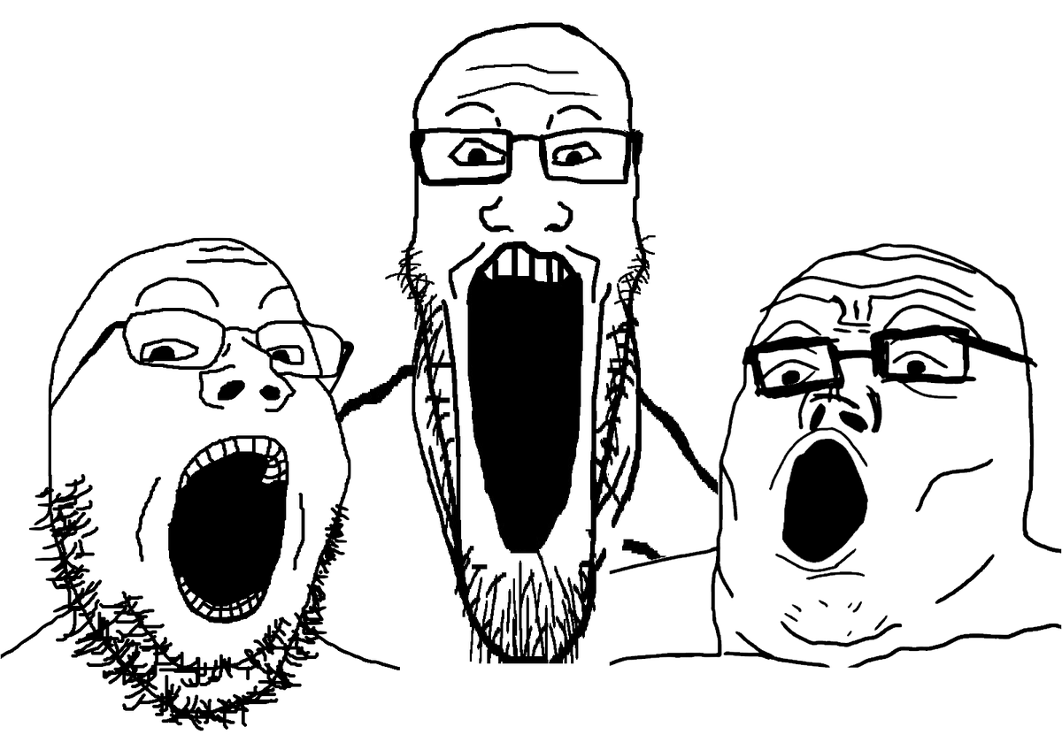
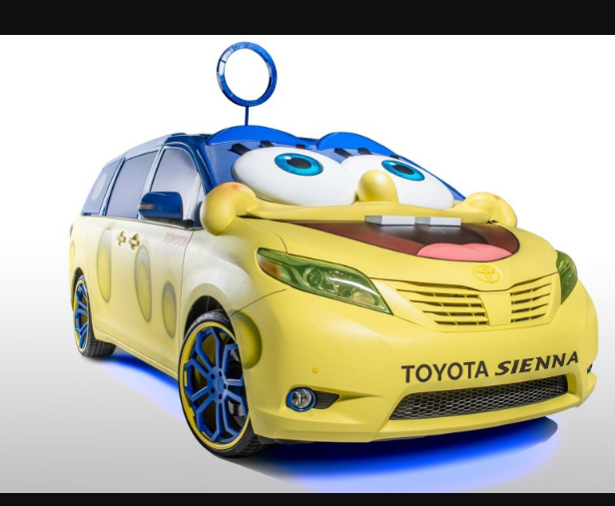
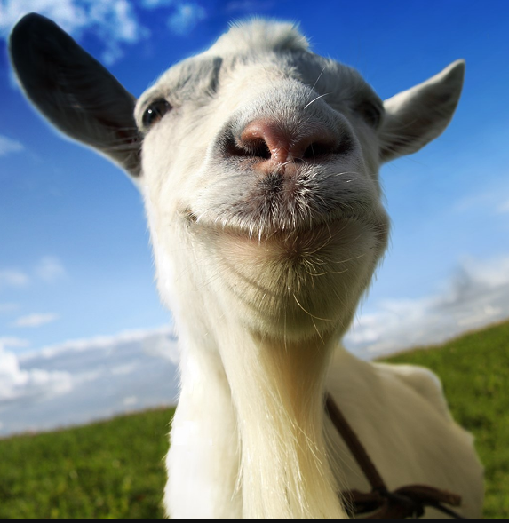
The Monty Hall problem
Presented by Thumindu Ranasinghe

Slide 2

What is the Monty Hall problemo

Slide 3
A host shows 3 doors 🗣️🗣️🗣️
2 doors have a goat and 1 has a prize
You chose a door you want to open
The host opens a different door showing a goat
The host asks if you want to stay with your door or switch to the one remaining
The host opens door, and you see what you got

Slide 4
How could you model this in Python
Use lists for the doors and the contents inside of it
Create a function for the game loop
Create a function for printing information
Use variables for the user’s choice
Use for loop to run the game loop to keep it repeating
Information for round can be stored in a list

Slide 5

Part 1
The user interacts with code and choses doors.

Slide 6
Part 2
Randomly stays or switches and randomly chooses doors. Simulated 50 to 10000 times

Slide 7
Part 3
Always stays and randomly chooses doors. Simulated 1000 times

Slide 8
Part 4
Always switch and randomly chooses doors. Simulated 1000 times

Slide 9
Part 5
Randomly stays and switch and randomly chooses doors. Simulated 1000 times. But with 10 doors

Slide 10
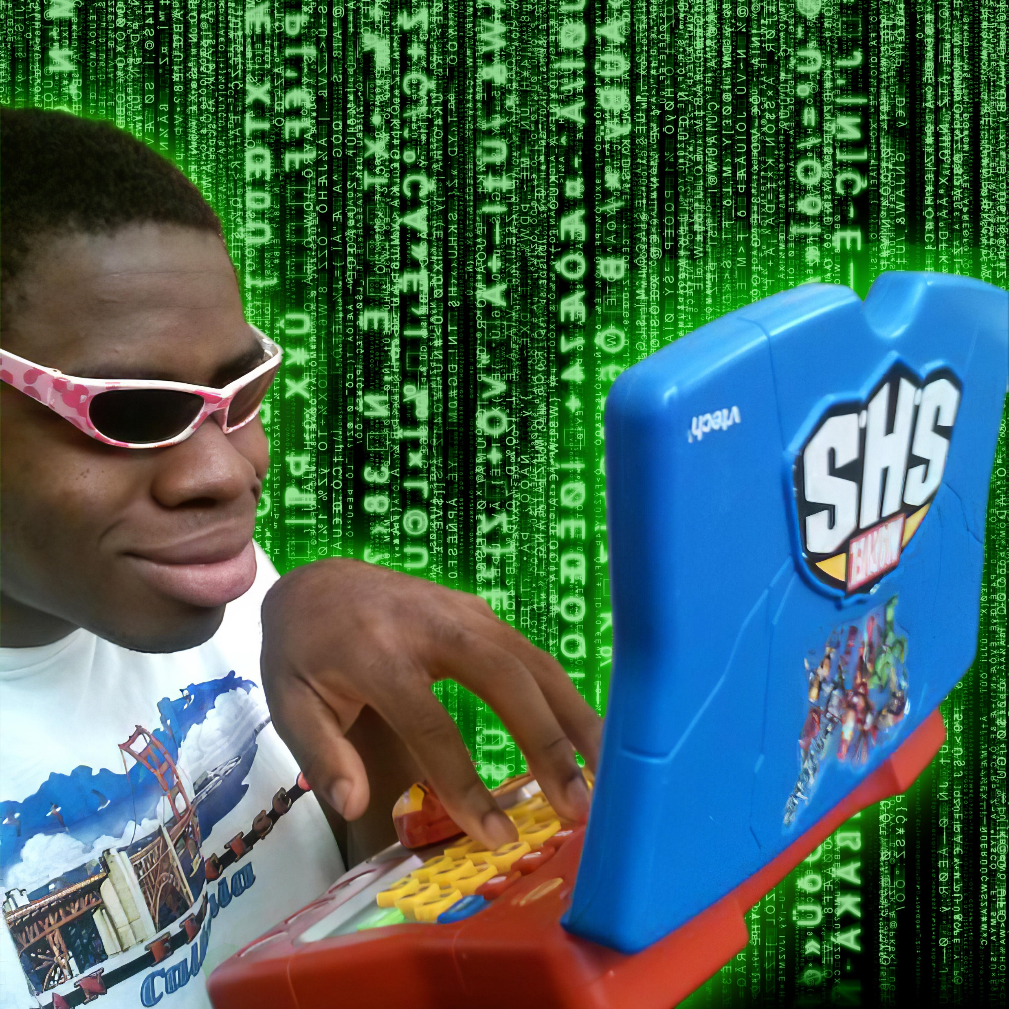
Game loop
Works for all parts (Makes it modular)

Slide 11
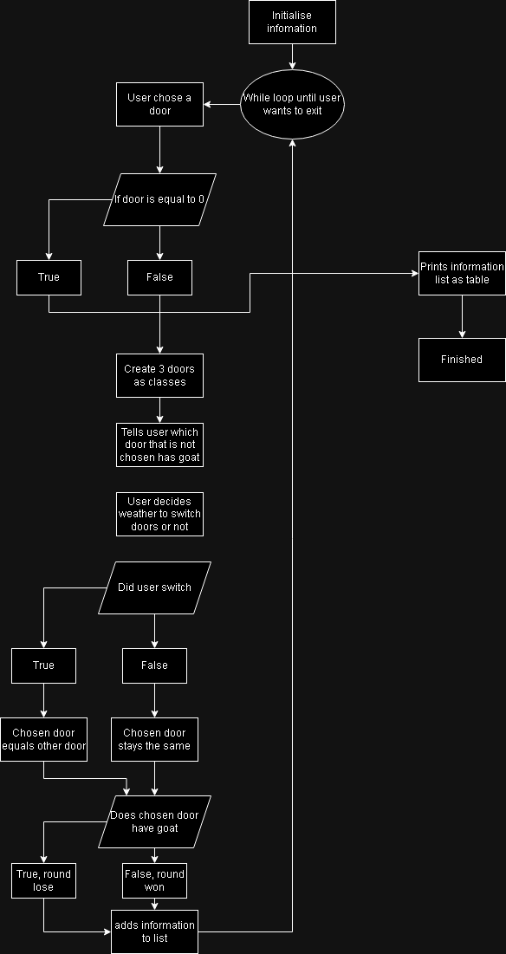

Slide 12
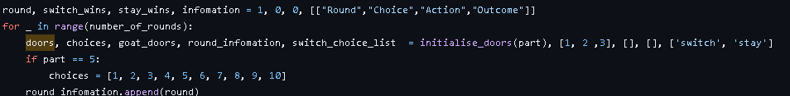
The initial setup
This code sets up all the variables for the start of the game. This is all done in the function called game_loop

Slide 13
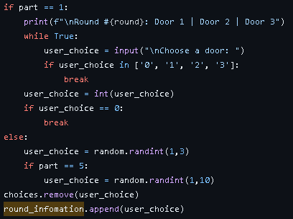
Choosing a door
This part of the code choses a door either for the user or from the user.

Slide 14
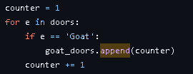
Finding out the goat doors
This for loop creates a list with all the doors with goats behind them apart from the one chosen by the user.

Slide 15
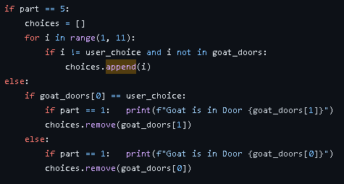
Revealing the door
These if conditions reveal the door to the user and remove that option from the choices list where the user can choose to switch to the other hidden door.

Slide 16
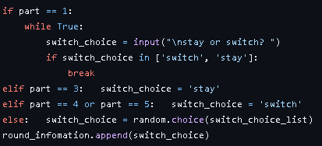
Second chance to change
This code is used to either switch to the remaining door or stay with the original.

Slide 17
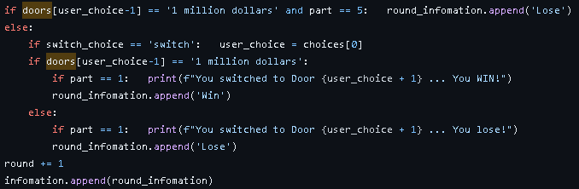
Winning or losing
This part determines whether the round was won or lost. The round is increased by one and the information for this round is added to a list.

Slide 18
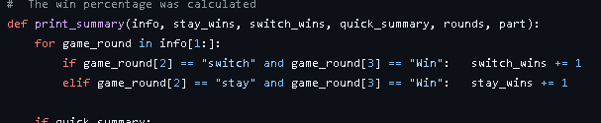
Printing the summary
This loop calculates how much time you won from switching and staying

Slide 19
Quick summarise print
This part of the code is only run for parts that only print the winning percentage and nothing else

Slide 20
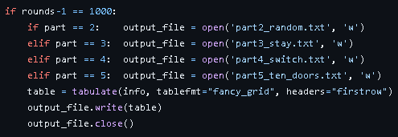
Writing to a file
In this part, the code writes the silent calculations to a different text file for 1000 rounds of the part.

Slide 21
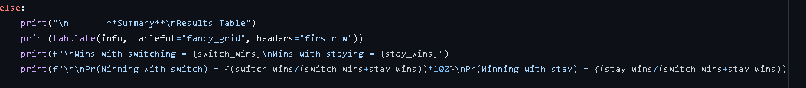
Part 1 print structure
If the quick summary is not true it runs this code that prints the usual summery with the table results and stats.

Slide 22
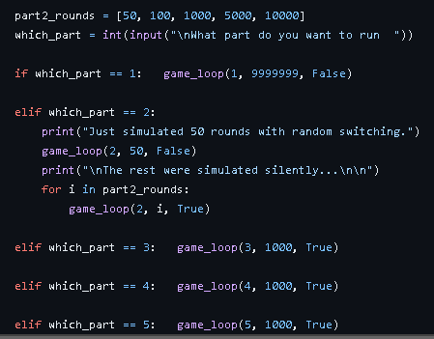
Menu
This is the menu system which contains if and elifs to help run the game loop with the correct parameters.

Slide 23
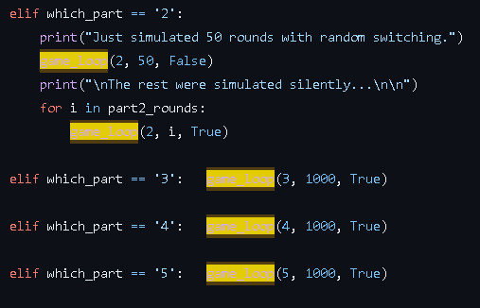
Game function
The one function the rules all. Parameters include, the part, number of rounds, and whether to do a short summary or not

Slide 24

Libraries
Tabulate: used to print information in tabular form
Random: to generate random numbers

Slide 25
Commits and Repository
Commits Repository

